Slide 1
Bellringer
Review: What were TWO examples of written forms of government in Chapter 2 Lesson 2?
Define: Patrons, Ethnic, Pacifists and Functioned in the “My Notes” of your Inquiry Journal

Slide 2
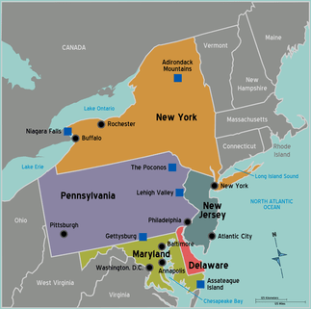
The Middle Colonies

Slide 3
New York and New Jersey
1660 – The English controlled two group of colonies:
New England Colonies (North)
Virginia and Maryland (South)
The Dutch controlled the land between these colonies
The colony was called New Netherland, very successful
Main Settlement was called New Amsterdam

Slide 4
The Success of New Amsterdam
New Amsterdam became a center for shipping to and from the Americas
Location had a good seaport
The seaport provided access to the Hudson River.
The river served as a major transportation link to rich lands farms, forests and furs

Slide 5
Patroon System
Patroons were landowners who received land grants in New Netherland from The Dutch West India Company.
The purpose was to increase the population in New Netherland.
Land was the reward for bringing settlers to New Netherland.

Slide 6
Think-Pair-Share
Why did the English want to take control of the Dutch colony of New Netherland?

Slide 7
New Netherland Becomes New York
England insisted that it had right to the colony.
In 1664 the English sent a fleet to attack New Amsterdam. The Dutch surrendered and the colony was New York.
New York continued to prosper, it had a diverse population
In 1664 NY had about 8,000 residents, by 1683 it grew to about 12,000 people.

Slide 8
Founding New Jersey
The Duke of York decided to divide the colony. He gave the land between the Hudson and Delaware Rivers to Lord John Berkeley and Sir George Carteret. The colony was named New Jersey after the English Channel Island, Jersey, where Carteret was born.

Slide 9
Quick Review
Read the second paragraph under “Founding New Jersey”.
Why did no major city develop in colonial New Jersey?

Slide 10
Pennsylvania and Delaware
Pennsylvania was founded by the Quakers, a Protestant group persecuted in England.
William Penn was given a land grant by King Charles.
Pennsylvania means Penn’s Woods
William Penn saw Pennsylvania as a “holy experiment”, a chance to put his Quaker ideals into practice.

Slide 11
Pennsylvania and Delaware cont.
Who were the Quakers?
Protestants who left England due to persecution
Believed everyone was equal
Believed people didn’t need a religious leader to worship
Pacifists – people who refuse to use force or fight wars
Philadelphia becomes America’s most successful city
Diverse population due to advertising all over Europe
Colonists could elect representatives

Slide 12
Pennsylvania and Delaware cont.
Swedish colonists had settled this land prior to English control
Penn allowed them to form their own laws
The colony became known as Delaware

Slide 13
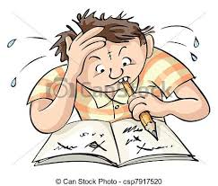
Chart Fill-In
Review pages 60-63. You have 10 minutes to complete the chart. I will randomly call on students to share their answers.

Slide 14
Research Activity
Examine the map on page 62. Based on the map, what goods are the middle colonies known for.
Research what goods your assigned area is known for today. Are they the same or different? Discuss why the products have changed over time…

