Slide 1
Bellringer
Annotate “The Middle Colonies” in your inquiry journals. Remember annotations include highlighting main ideas, writing in the margins, exclamation marks (items on the test) and questions marks (questions you still have)
Answer Guiding Questions on page 60 and 61 in your textbook
Think about what life would have been like to walk down a busy street in the port city of New Amsterdam/New York City. What might you have seen, heard and/or felt?

Slide 2
The Southern Colonies

Slide 3
Virginia and Maryland
The Virginia colony depended on tobacco for its success
Labor was needed to grow this valuable crop
Enslaved Africans #1
Criminals working for freedom
Indentured servants #1

Slide 4
Virginia and Maryland (cont.)
1634 – Maryland is founded. Sir George Calvert, Lord Baltimore, wanted a safe place for English Catholics #2
They faced persecution in England
1649, Act of Toleration protected religious freedom
Maryland had many plantations
Need for labor was very high
Maryland and Pennsylvania argue over borders
Mason-Dixon Line became the official boundary

Slide 5
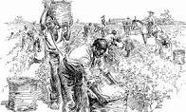
Think About It
How did the growth of plantations contribute to the rise of slavery?

Slide 6
Virginia and Maryland (cont.)
Virginia settlers begin moving onto Native American lands
A deal is struck to stay off Native land/prevent war
Some Virginians disagree with this deal
1676 - Bacon’s Rebellion
Nathaniel Bacon leads attacks on Natives and Jamestown
Rebels wanted to move west onto Native lands, the colonial government wanted to stop this expansion. #3
He dies just before victory
Rebellion fades, but government learns not to ignore its people

Slide 7
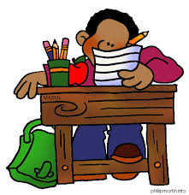
Chart Fill-in
With your table or independently read the rest of the chapter to complete the chart in your journal. Each table will be asked to share their answers!

Slide 8
Writing
Pretend you were alive during the time of Bacon’s Rebellion. Write a diary entry explaining the events of the day. Make sure you include background information as to why the rebellion occurred.
Perspectives (Choose 1)
Native American, whose village was burned
Settler that joined the rebellion
Government worker in Jamestown as rebels stormed in

